Slide 1

Aarogya Online Ambulance : Unveiling the Online Ambulance Booking Service and Booking Procedure
TEAM MEMBERS
Shivam Maheshwari (2110915011025)
Vasudev (2110915011029)
COURSE – BCA Final

Slide 2
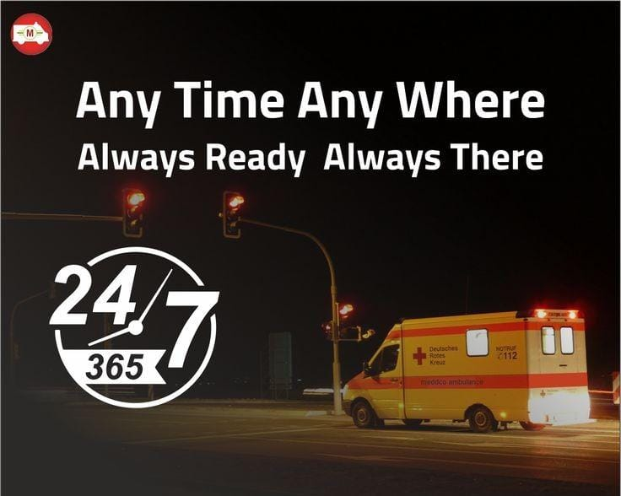
Introduction
Welcome to Aarogya Online Ambulance. Explore the online ambulance booking service and its booking procedure. Discover how this service revolutionizes emergency response. Join us in this insightful journey.

Slide 3
CONCERNS WITH OFFLINE AMBULANCE
No Proper tracking of bookings
Improper monitoring
Delayed response
Limited ambulance availability

Slide 4
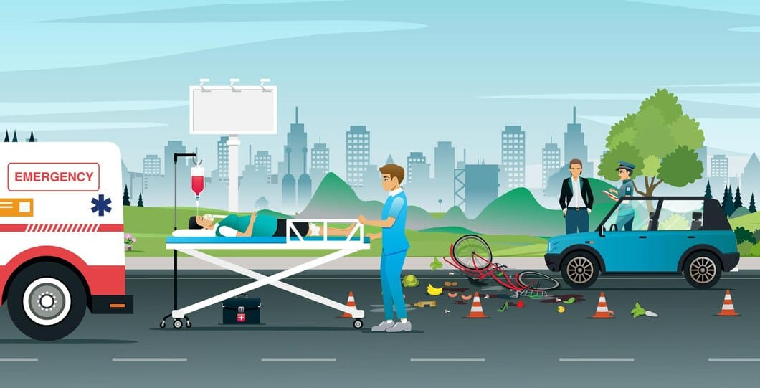
BENEFITS OF ONLINE AMBULANCE BOOKING
Timely response
Proper tracking for booking
Proper records maintained
Wide ambulance network
High availability
Initial Treatment within Ambulance

Slide 5
Key Features
Patient can check information about ambulance and drivers
Easy to book
Affordable price per booking
Wide ambulance network leads to timely treatment

Slide 6
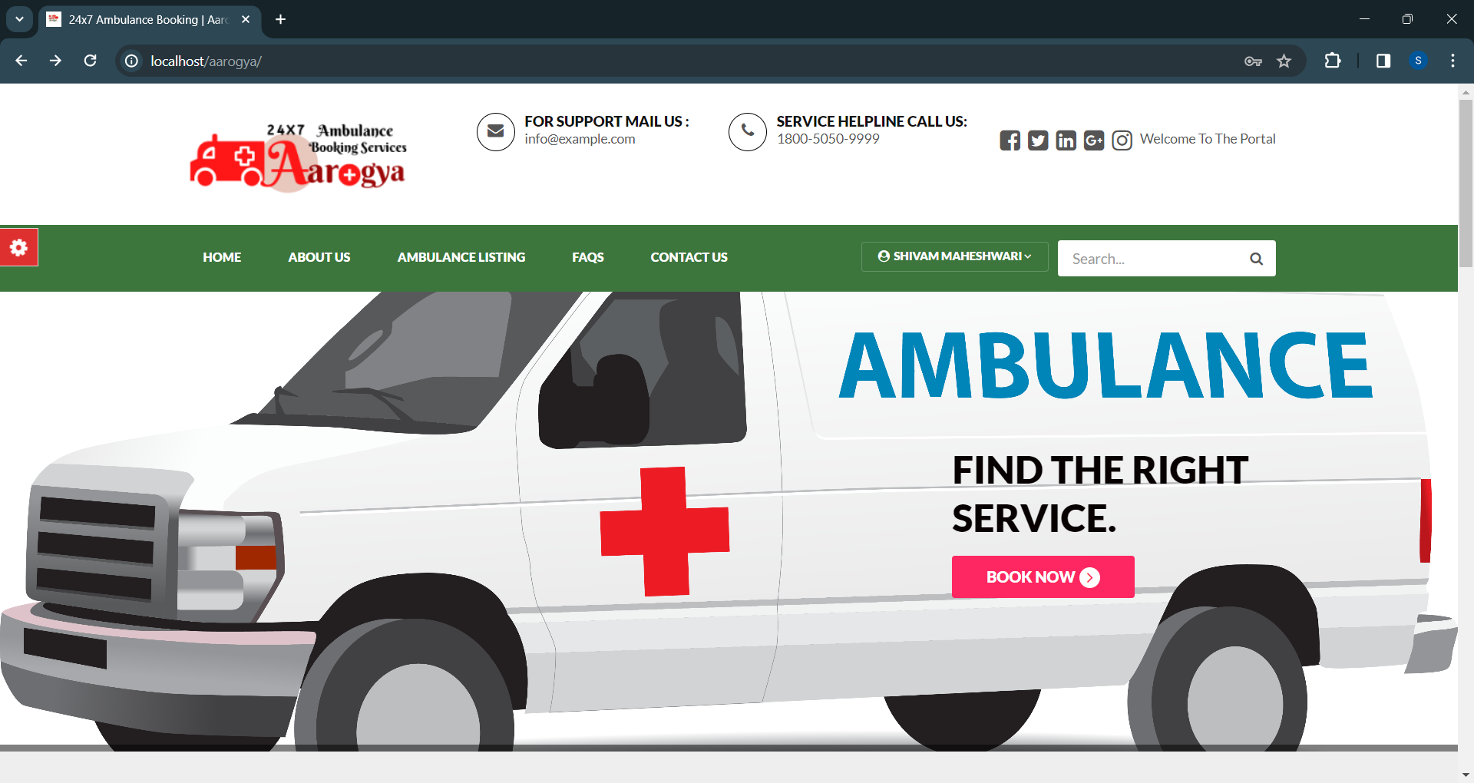
Booking Procedure
Visit http://localhost/aarogya/
Click on Login/Register
Click On Book Now Button
Select the Ambulance category
Fill the details and click Book Now
To check Booking status
Click on User Name
Select My Bookings

Slide 7
Impact on Healthcare System
Improves the condition of Ambulances
Increases emergency service quality and performances
Reduction in mortality rate due to lack of timely treatment
Wide network of ambulances and hospitals
Timely medical care

Slide 8
Employment opportunities
Providing employment to drivers
Providing employment to healthcare workers

Slide 9

Community Engagement
Empowering the community with the knowledge of online ambulance booking.
Encouraging widespread adoption and promoting a culture of proactive emergency preparedness. Together, we can make a diﬀerence.

Slide 10
Conclusion
In conclusion, the Aarogya Online Ambulance booking service represents a signiﬁcant advancement in emergency healthcare, providing a vital lifeline for individuals in need of urgent medical transportation. Its innovative approach and commitment to quality make it a cornerstone of modern emergency medical services.

Slide 11
Thanks!
Do you have any questions?

